Slide 1
Setting Up the Perfect Online Resume
<Name>
<Title>| <Company>
<email> | <Social Media optional>

Slide 2
The internet is an incredible source of information
(Image)

Slide 3

It also provides information about you
(Image)

Slide 4
Potential employers look you up on the web
(Image)

Slide 5
You can influence what they see
Stefan Milea

Slide 6




Creating an online resume allows you to present yourself the way you want to be seen

Slide 7
Creating an Online Resume

Slide 8
If you get lost at any point DON’T PANIC, just remember this URL
aka.ms/onlineresume

Slide 9
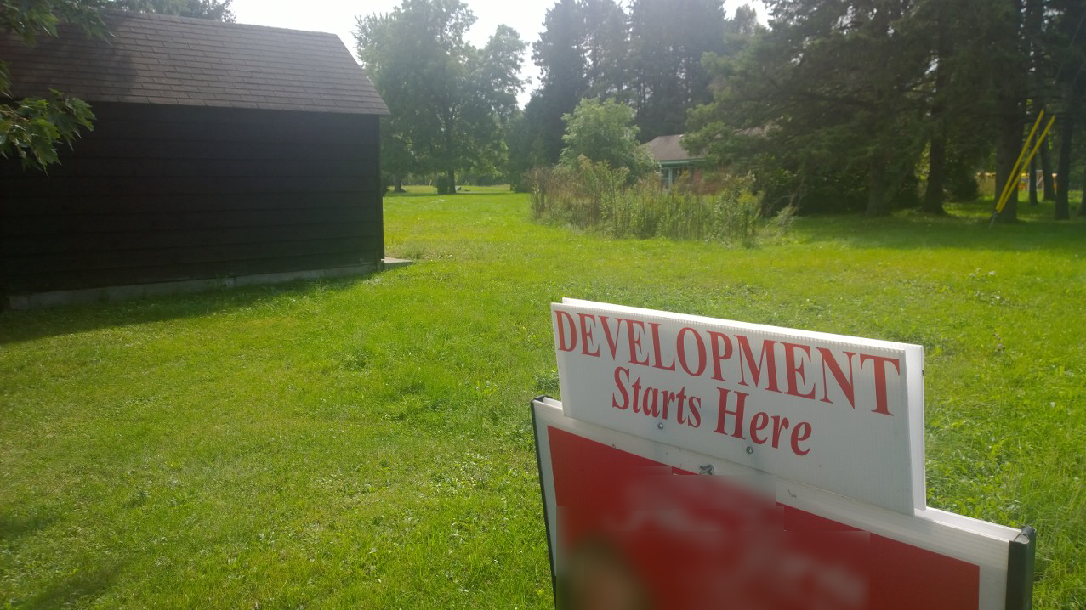
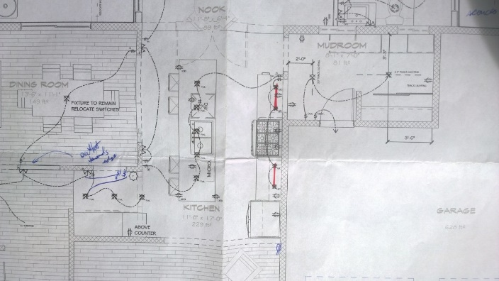
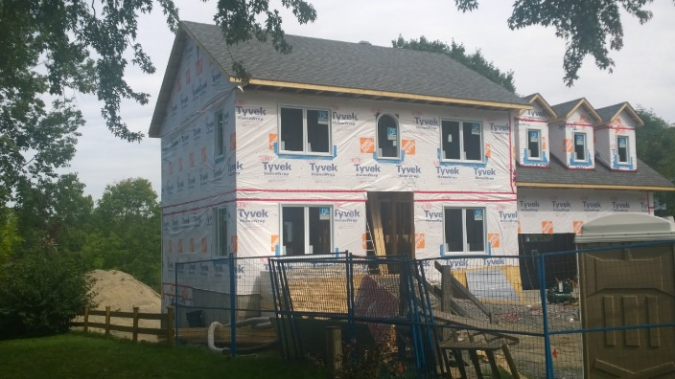
How do we do it?
LOCATION
DESIGN
CONSTRUCTION
Location
Design
Construction

Slide 10
Location

Slide 11


You need a place to host your online resume.
+

Slide 12

Log into DreamSpark
Go to www.dreamspark.com
Select students
Select sign in
Log in with your Live account (if you don't have one create one at account.live.com)
Associate your live account with your school account
Select verify your student status | I have a school email account
Enter your school email address
(Image)

Slide 13
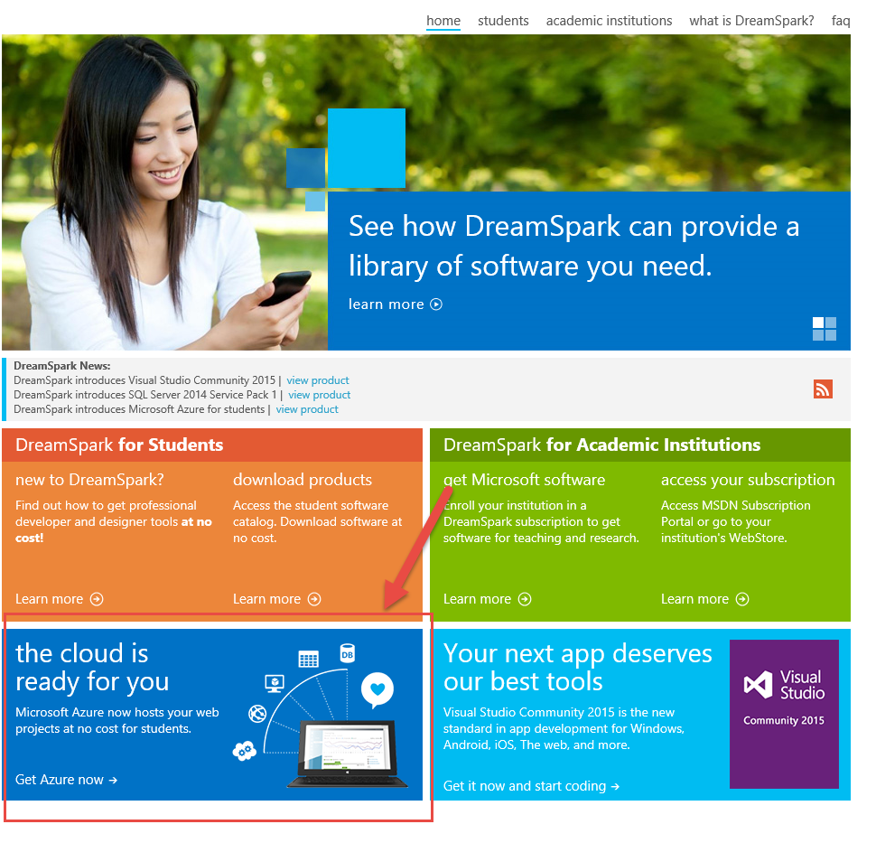
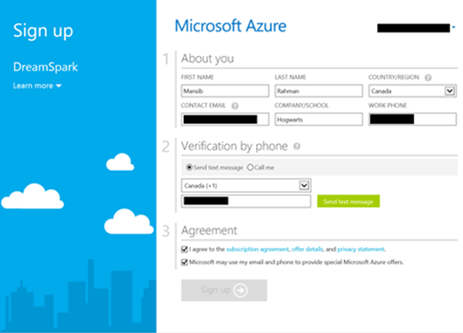
Activate your Azure benefit
On the DreamSpark website:
Select Home | Get Azure now | Register now
On Azure sign up page:
Select a verification method, request and then enter your code
Agree to the Terms and conditions and choose Sign Up
(Image)

Slide 14




Microsoft Azure Web Sites
Start Simple
Code Smart
Go Live
Create new sites in seconds
Easily manage and scale your sites
Automatic load balancing and shared storage across instances
Scale out or up to reserved instances for improved performance and scale
Built-in web jobs support
Use ASP.NET, ASP, PHP, Java, Node.js, Python
SQL Azure or MySQL databases
Start with open source apps and frameworks
Develop with VS and WebMatrix
Supports any Web development tool on any platform (Windows, OSX, Linux)
Rapid deployment for quick iteration
Integrated source control with Team Foundation Server (TFS) and Git
Built-in monitoring of perf and usage data
Quick access to request logs, failed requests diagnostics and diagnostics

Slide 15
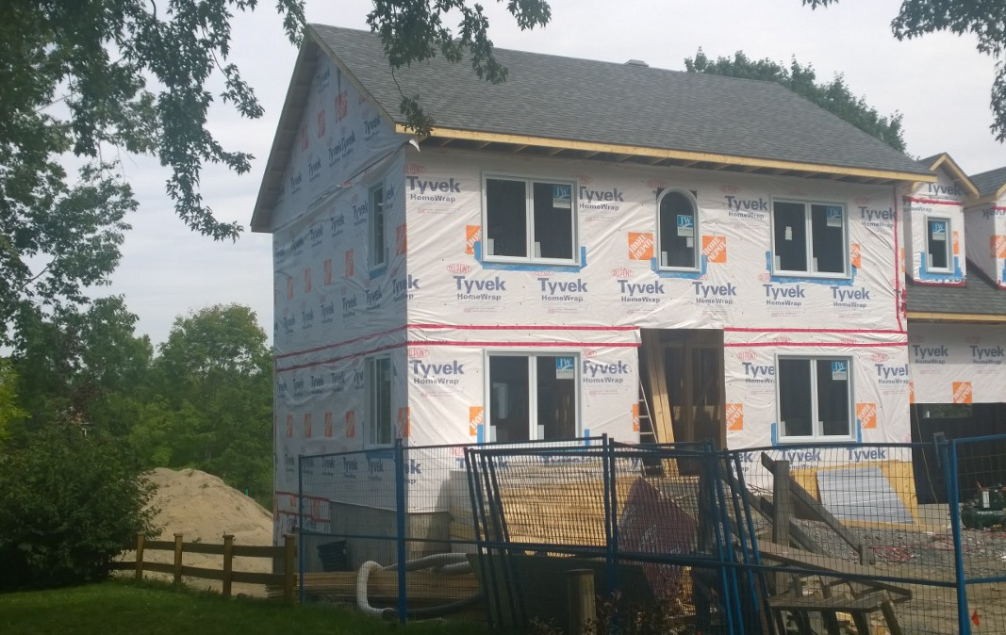
Construction

Slide 16

Create a WordPress website on Azure
Go to manage.windowsazure.com
Log in with your DreamSpark live account
Select +New > Web + Mobile > Marketplace
Search for and select WordPress
Select Create
Enter web hosting settings
Web App (name for your website) e.g. SusanIbach.azurewebsites.net
Create New Resource Group
Select App Service Plan
Create New Database – select Mercury (free tier)
Select Create
(Image)
Notes:
suzanneibach@outlook.com G0DevMental
WordPress account suzanneibach G0DevMental

Slide 17
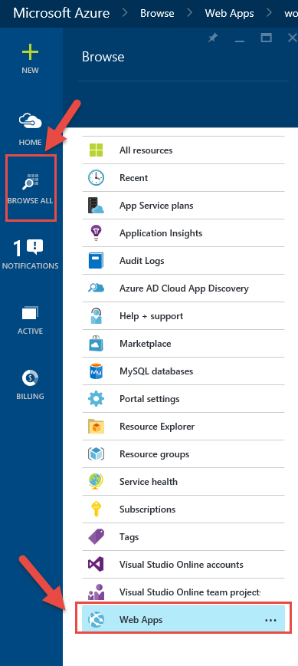
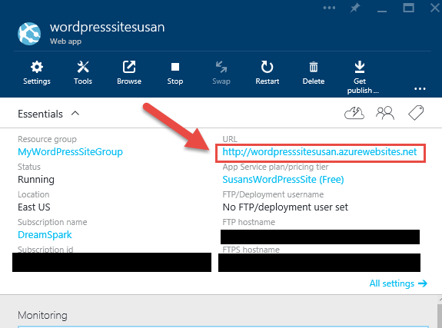
Let's edit our website in WordPress
Sign in at manage.windowsazure.com
Select Browse All > Web Apps > Your site
On the blade click on the URL to navigate to your WordPress website.
(Image)

Slide 18
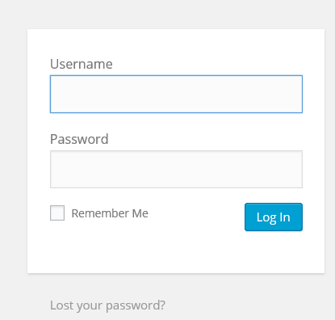
The first time you visit you need to install WordPress and create an account
Don’t forget your username and password!
You will need it anytime you want to update your resume
(Image)

Slide 19
Log in to WordPress to edit your new website
If you visit your site and don't see the log in screen add /wp-admin to your URL
(Image)

Slide 20
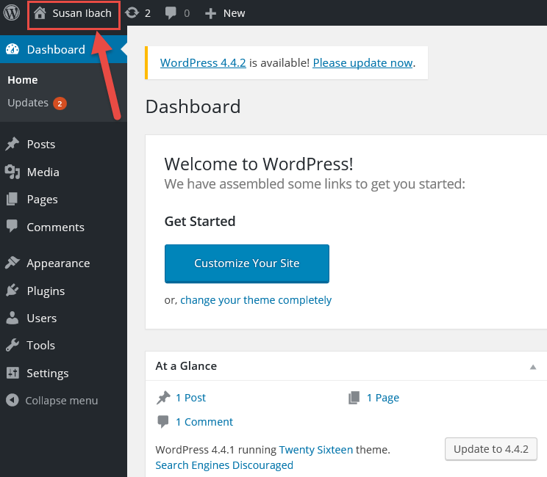
The WordPress admin site
The admin site allows you to edit your website
Toggle between the dashboard view and the user view

Slide 21
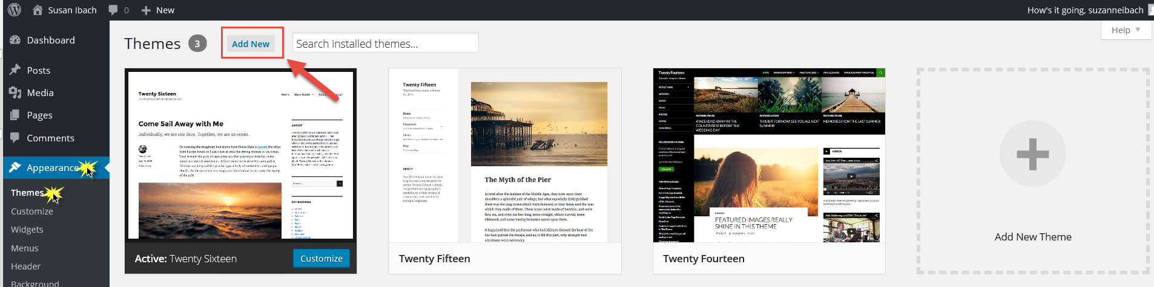
Pick a theme for your WordPress site
The theme determines the look, feel, and functionality of your site
If you change the theme after you start, expect rework
Themes are provided by WordPress, developers, and companies
Choose Appearance | Themes to install and select themes

Slide 22
Which theme should you use?
Be wary of themes created by “Joe Developer”
Twenty Fifteen is the theme used in this session
Paid themes are available from third parties
http://themeforest.net/
http://www.elegantthemes.com
http://www.elegantthemes.com/gallery/myresume/
!
TIP: Make sure the theme you pick looks good on different size screens.
You can resize your browser to pretend you are on a phone or tablet

Slide 23
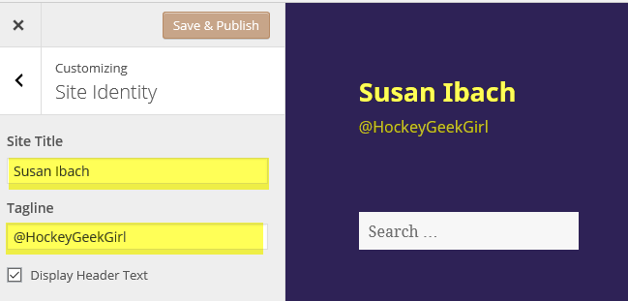
Display your name and contact information
Resumes typically display the candidate name and email address at the top of the page
TIP: What is your email address? WootWoot57@Hotmail.com might seem unprofessional
Appearance | Customize | Site Identity
Site Title - Name
Tagline – email address

Slide 24
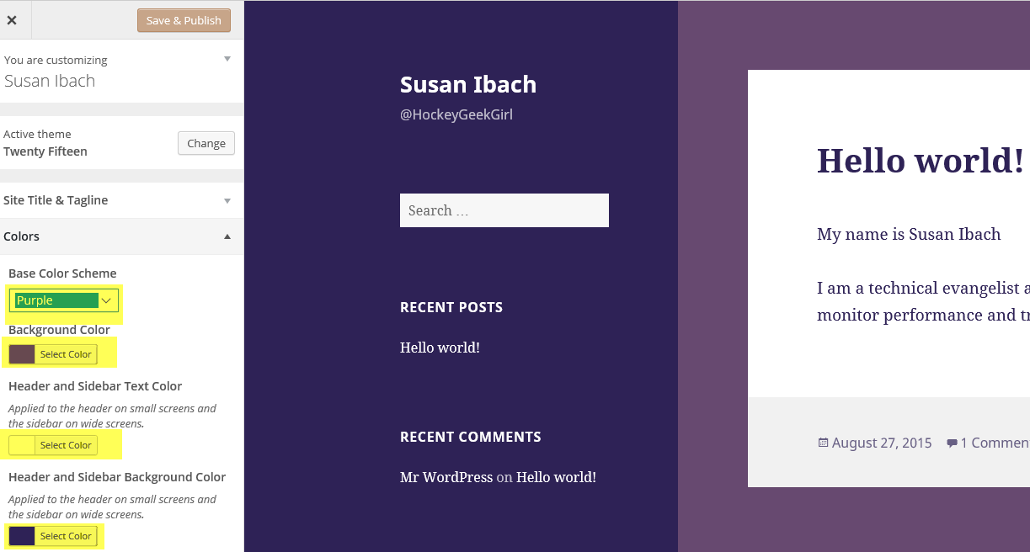
Set your colour scheme
The colour scheme is a great way to bring your personality and style to the page
Appearance | Customize | Colours
Warning: ugly and multiple colors can distract from your skills.

Slide 25
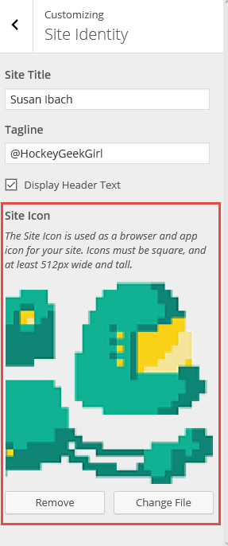
Sometimes the little details set you apart
Add a site icon
Appearance | Customize | Site Identity
Upload an image to use as your site icon
Maximum size 8 MB
Square image (or it will crop to square)
512x512 pixels minimum

Slide 26
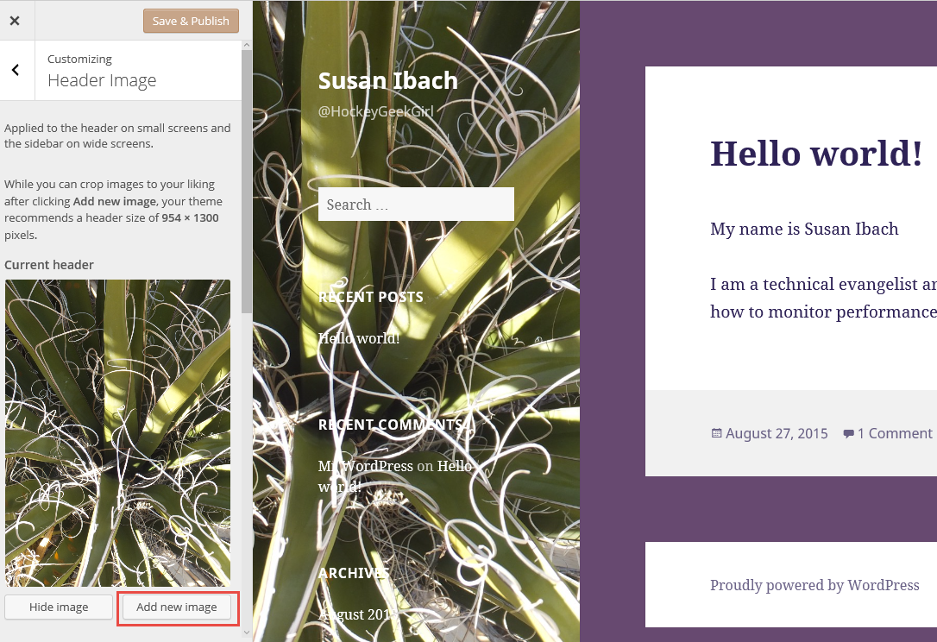
Images can add personality to your site
You can add header or background images
Appearance | Customize | Header Image
Appearance | Customize | Background Image

Slide 27
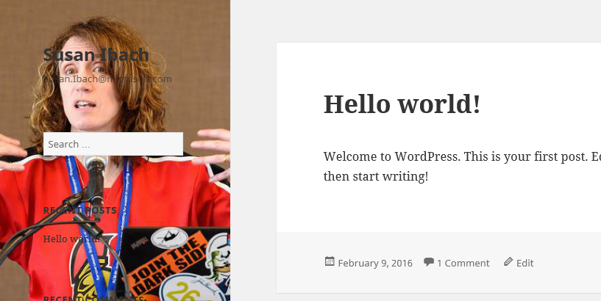
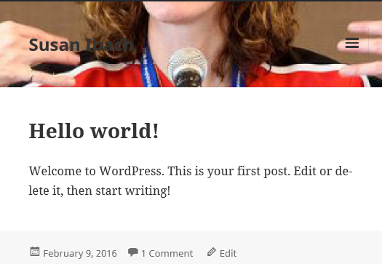
Watch out for cropping on different screen sizes
Pictures may be cropped when you display them on different screen sizes. So make sure your image works on smaller screens with your selected theme

Slide 28
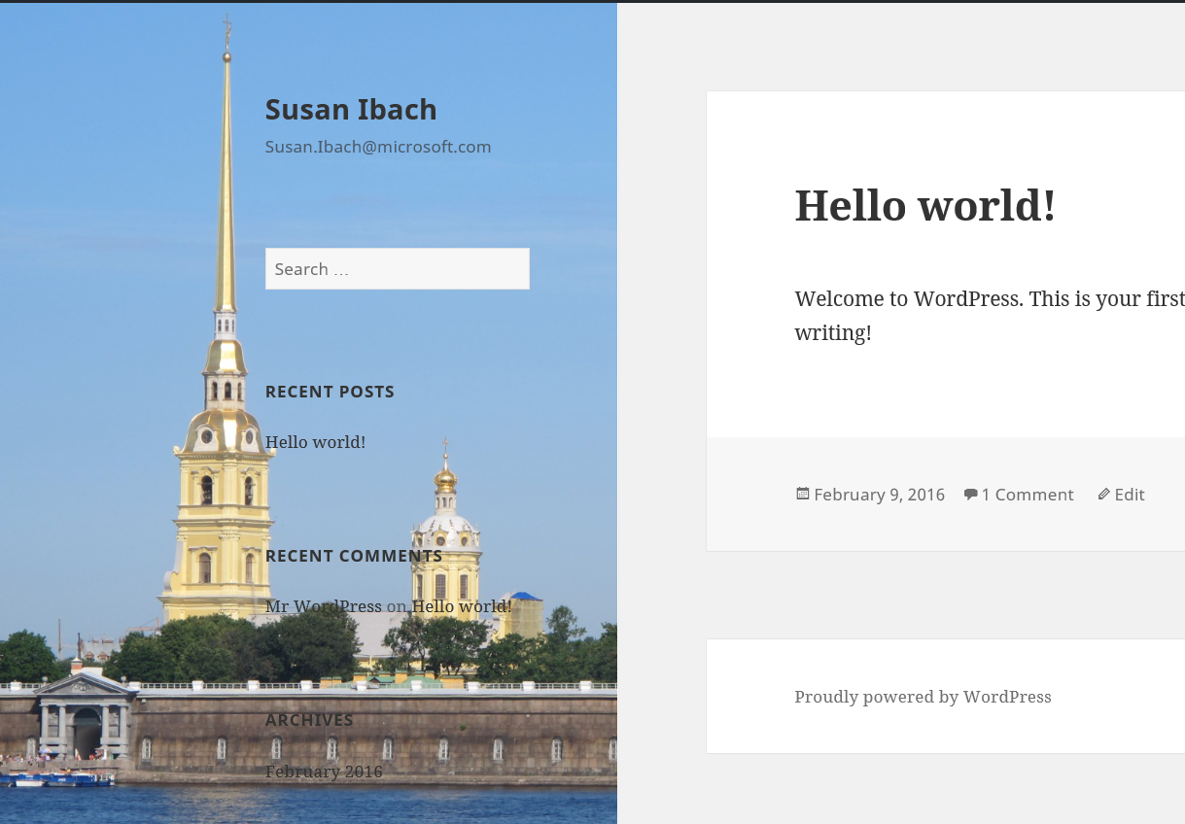
Can I still read your resume?
Is there enough light/dark contrast to read the text with a picture in the background?

Slide 29
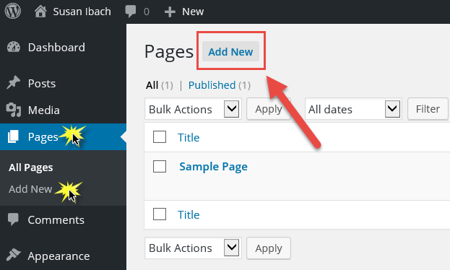
Let’s create a page to display our resume
Pages | Add New

Slide 30
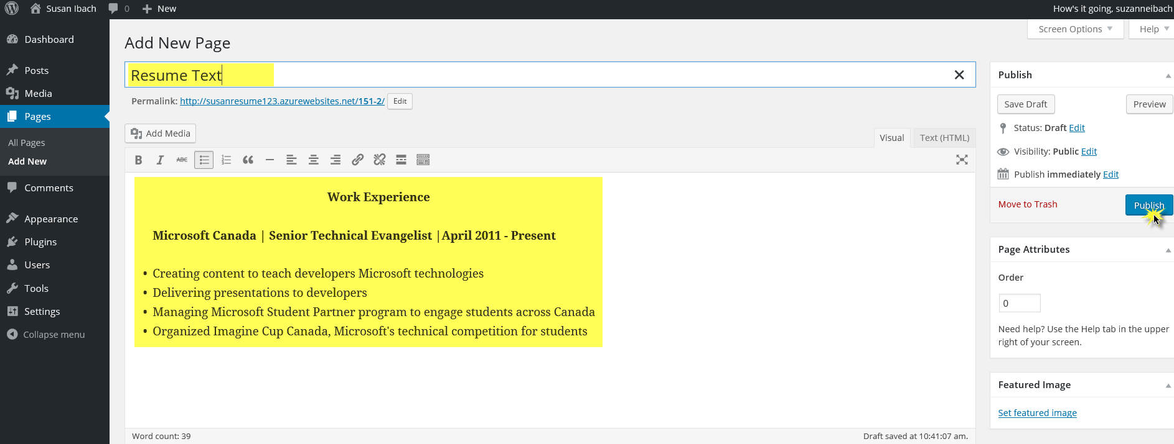
Use the editor to create your page
Give your page a title, add the desired text and Publish

Slide 31
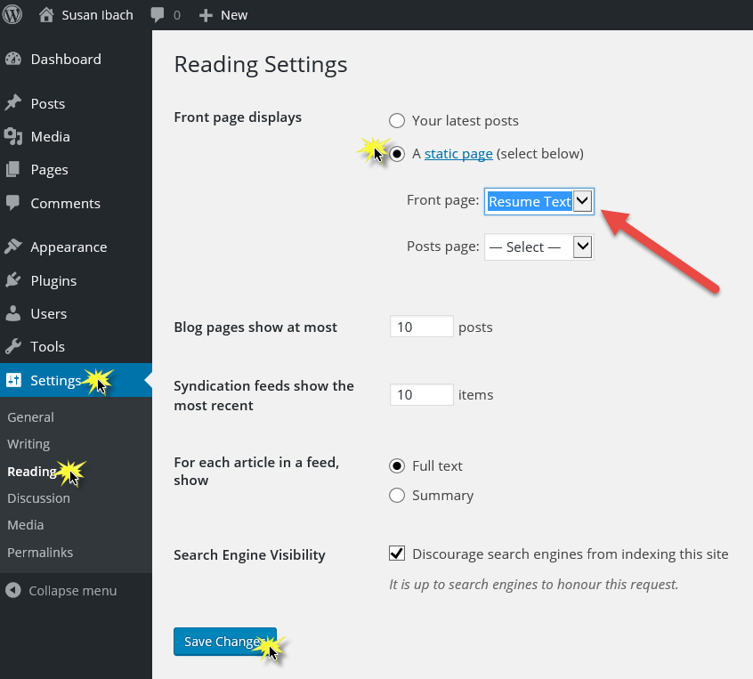
Set the resume page as your landing page
Settings | Reading
“Front page displays”

Slide 32
Break the “one page” rule!
What is “one page” on a website?
Create additional pages to show your work!
Projects?
Presentations?
Competitions?
Portfolio?

Slide 33
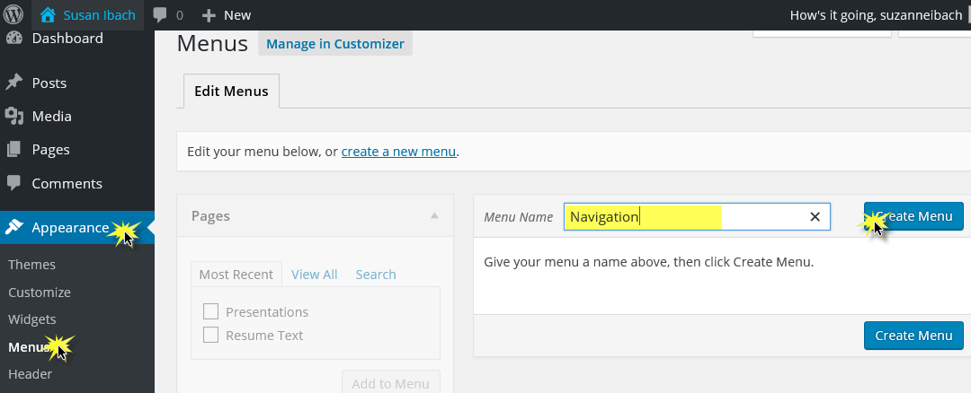
Add a menu to navigate between pages
Appearance | Menus

Slide 34
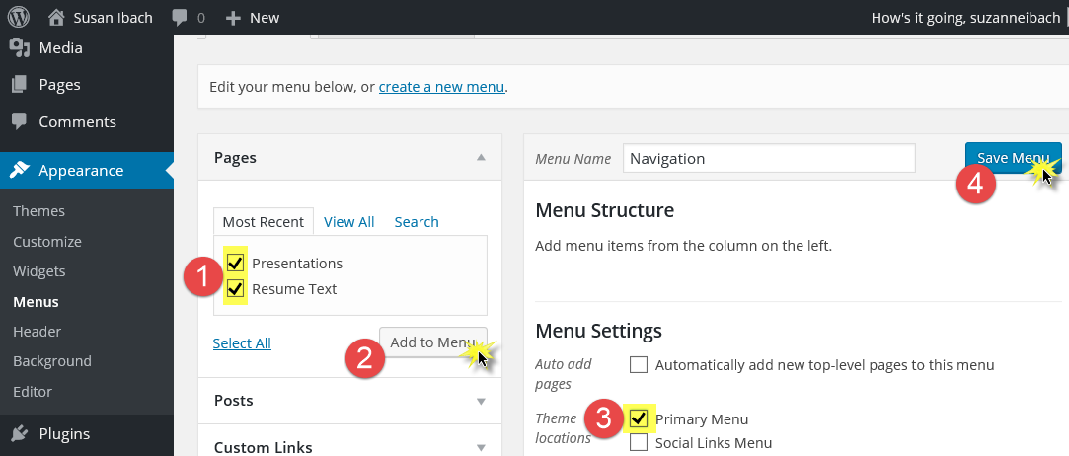
Add a menu to navigate between pages
Add your pages to the menu and set as the Primary menu

Slide 35
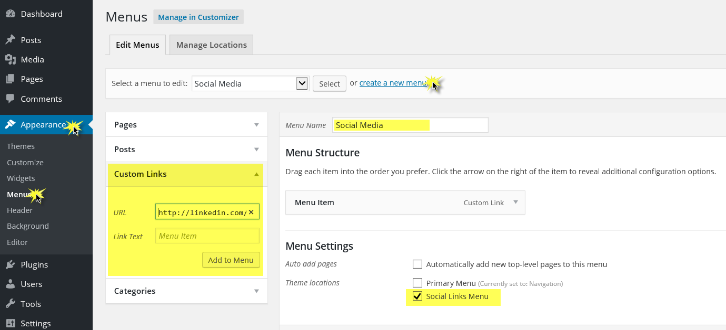

Share links to your professional profiles
Theme Twenty-fifteen has a social media menu feature
Create a new menu and select Social Links Menu
Add Custom links to your social media
LinkedIn
Twitter
GitHub

Slide 36
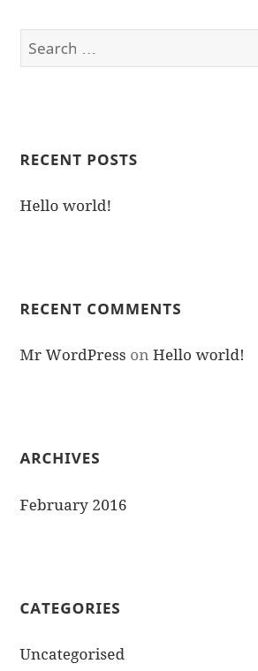
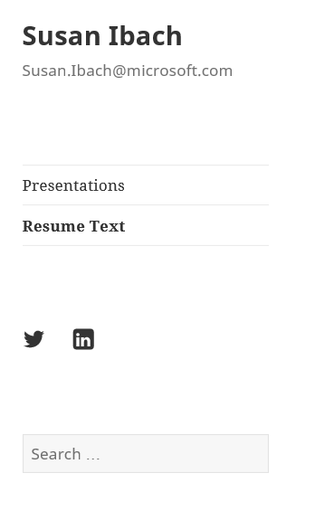
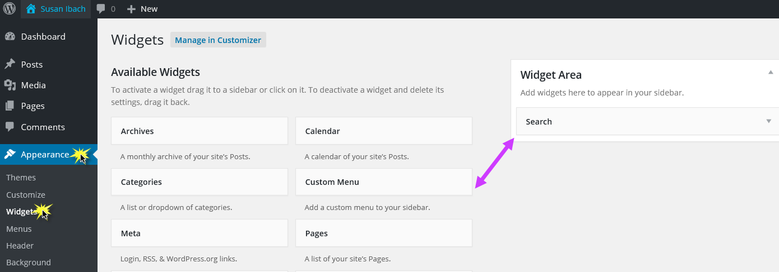
Get rid of clutter
Those extra controls are called widgets
Remove the ones you don’t want
Appearance | Widgets

Slide 37
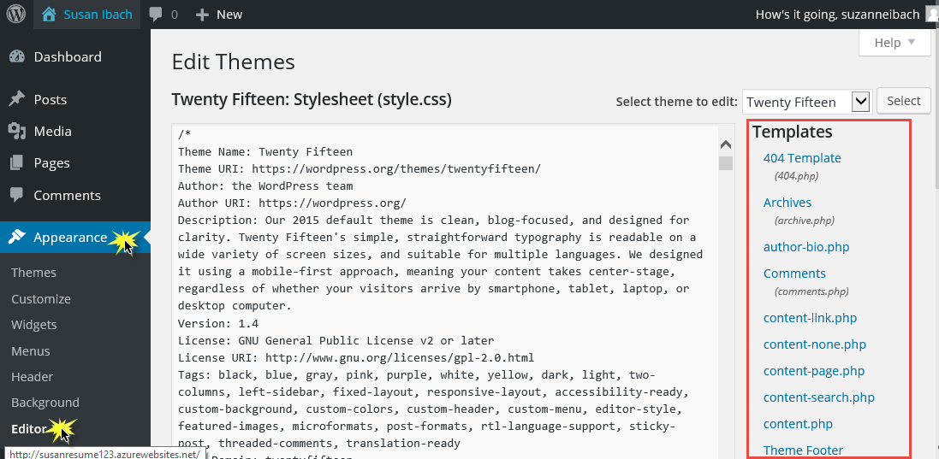
If you know your way around HTML/CSS/PHP
All the HTML CSS and PHP used for the site is exposed.
You can edit the files to customize the appearance even further!
Appearance | Editor

Slide 38
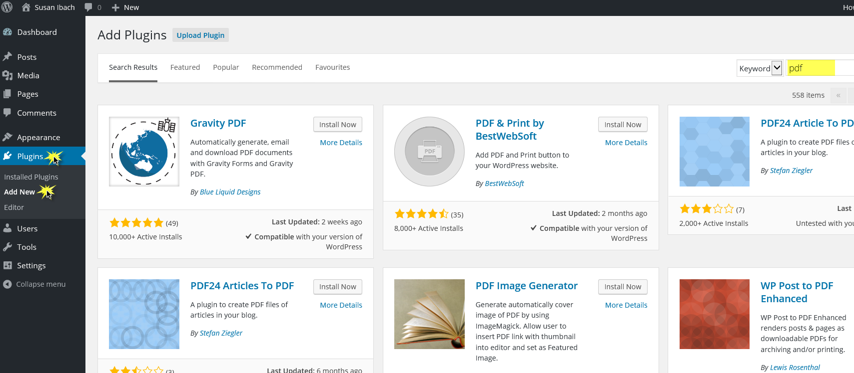
Explore plugins to add more functionality
Plugins | Add New

Slide 39
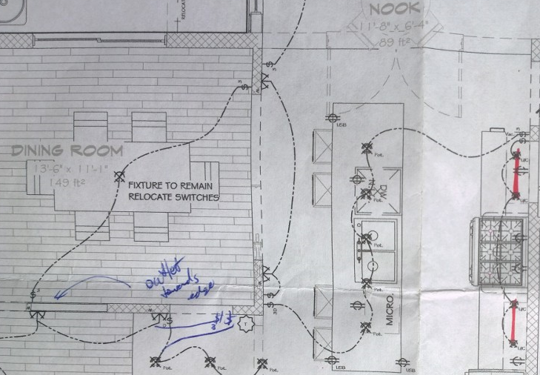
Design

Slide 40
Online Resume DOs and DON'Ts

Slide 41

You want your resume to get you an interview
Average time spent by recruiters looking at a resume: 5-7 seconds
Make sure your most relevant skills are listed first
Lists are faster to scan than paragraphs
Get to the point fast: what have you done and what can you do

Slide 42




DON'T just cut and paste your paper resume
Paper resumes can be tailored to each job application
Online resumes should complement your paper resume and can be read by any potential employer
You can have a link to view or print a paper resume from your online resume
Stefan Milea
Stefan@contoso.com
@StefanTheCoder
See my projects
My Experience
Stefan Milea
CV
Print my CV

Slide 43
DO include links to your work
Apps or websites you published
Conferences you helped organize
Work completed on internships
Blog posts or articles you wrote
Class projects
Competitions, hackathon projects, or prizes
Code you have shared on GitHub
Videos of you presenting or showcasing your work

Slide 44

DON'T have a paper and an online resume that present two different people
I
Microsoft
I
Microsoft
I
Google

Slide 45
DO include testimonials
Reviews from past managers
Kudos for volunteer work you completed
Compliments from faculty
It is a courtesy to ask permission before quoting
"I just want to write with my profound thanks for how much you’ve helped us get to this point. I have a real appreciation of your commitment and expertise, especially your expertise! I’m so inspired and am grateful for your partnership!" – Stefan Milea, supervisor on learn to code project

Slide 46

DO list your programming languages
List them from most to least proficient
When you mention a project specify languages used
Be careful ranking your skill from 1-10
Do you think an employer will believe you are a 9 or 10?
Do you want to list the language if you are a 1 or 2?

Slide 47
DON’T lie
Seriously, that is the worst thing you can do on a resume!

Slide 48
DO describe what you have done
List accomplishments from past jobs and roles, not just responsibilities
Quantify what you can
Supervised a team of 4 people
Increased usage by 15%
Improved performance by 5%

Slide 49
DO give yourself credit
If you don’t have much work experience
Highlight your transferable skills (communication skills, interpersonal skills, industry knowledge)
List memberships in professional organizations (IEEE, AIESEC, ACE)
List volunteer work and activities

Slide 50
DO include contact information
What email account should you use?
You don't want to miss an email about a job because you weren't checking your school email
Have a professional looking email address I might not hire sexybunny48@Hotmail.com

Slide 51


DO check what your social media says about you!
Include links to the social media that presents you professionally
Set privacy settings on social media accounts you use personally not professionally so they do not appear in search results
If you have a LinkedIn account, make sure it links to a current email address and that your profile is up to date

Slide 52
DO pay attention to details
NO spelling mistakes!
Pick a font that is easy to read and looks professional
NOTE: In WordPress, changing a font requires using a plug in such as simple custom css
What font should I use? Five principles for choosing typefaces
The colours and photos you add to your site create a powerful first impression. Make sure it's a good one.

Slide 53
DON’T create it and forget it
Update your online resume regularly. At least once per semester.
I
Windows 10
I
Windows 8

Slide 54
DO show me how you learn and grow
I don’t expect you to know everything walking in the door
I do expect you to be able to learn on the job
What did you teach yourself outside class?
How did you apply what you learned in class outside the classroom?

Slide 55
DO Provide “Team player” examples
Everyone says they are a team player, if you can provide specific examples, do it!
You don’t have to be the team captain
Sometimes I want you to be a leader
Sometimes I want you to be a follower

Slide 56




DO provide a professional photo
Start with a high resolution and shrink it to a smaller file, don’t take a small picture and make it bigger
If you don’t have access to a studio, take a picture outside on a cloudy day for the best natural lighting
Resize and edit the photo with a tool such as Adobe Photoshop (some schools have computers available with Photoshop) or check out open source editing tools such as Gimp

Slide 57
HR FAQs got questions about jobs at Microsoft?
aka.ms/onlineresume

Slide 58
The best way to a great career is to keep learning and keep exploring!

Slide 59
Can’t remember all of that?
aka.ms/onlineresume

Slide 60
Event Evaluation
<insert event evaluation here>

